Slide 1
NBA: Bayesian Skill Ranking
Leland Chen, Joseph Huang, Ryan Thompson

Slide 2
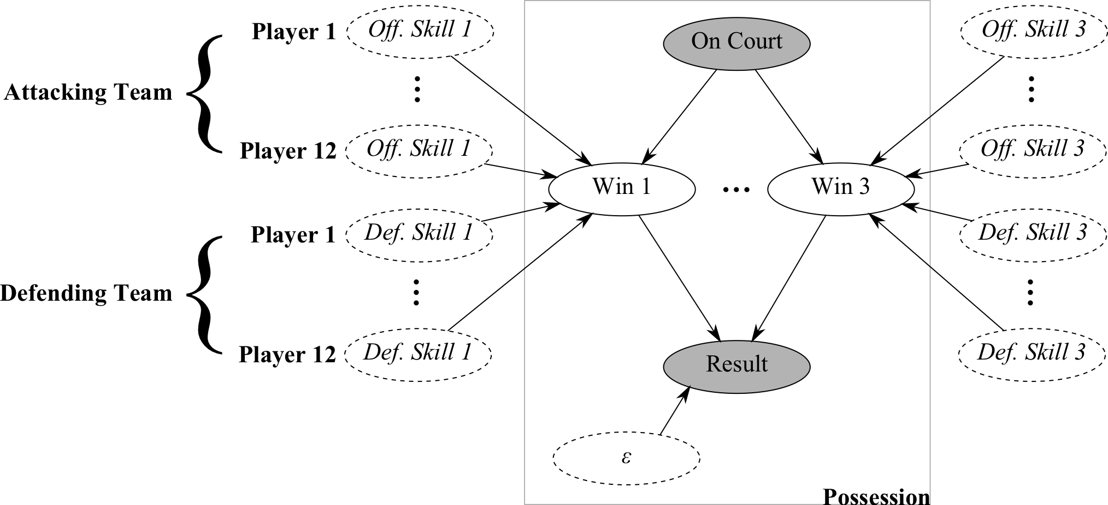
Proposed Network

Slide 3
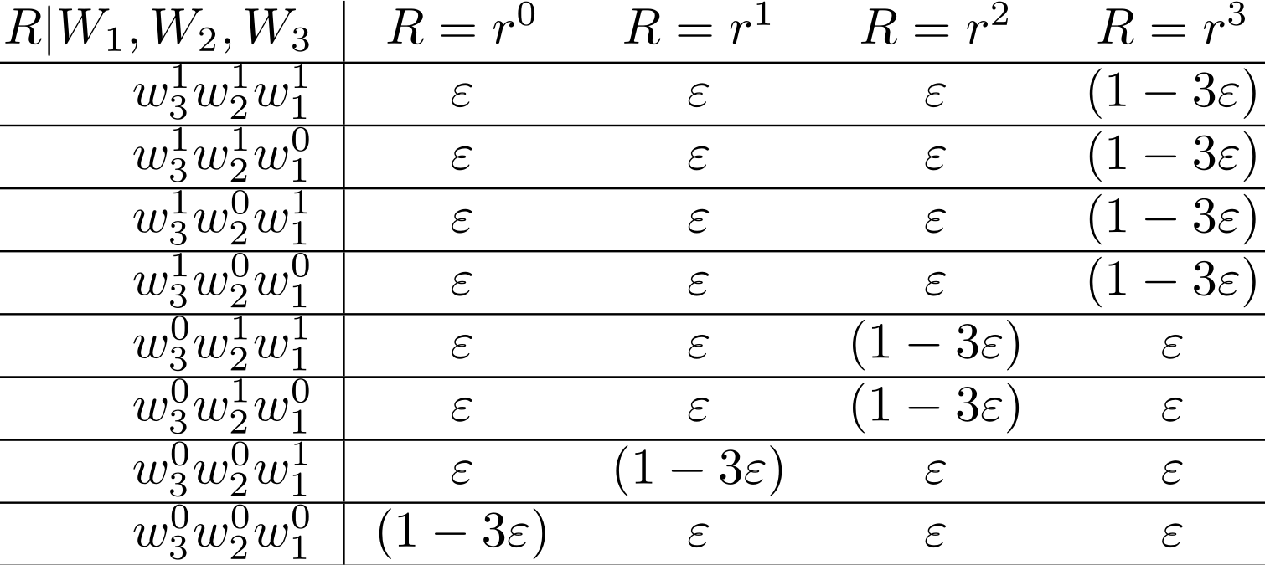

Slide 4
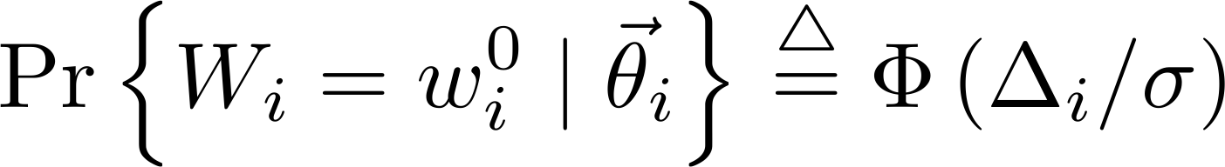
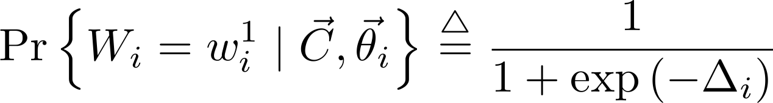
Gaussian
Logistic

Slide 5
Case Study: One Game
Offensive/Defensive Skills
 | Off. 1 pt | Off. 2 pt | Off. 3 pt | Def. 1 pt | Def. 2 pt | Def. 3 pt
Zydrunas Ilgauskas | -52.282 | 9.000 | 34.708 | 16.104 | 18.088 | 7.638
Offensive Skills: Higher the better
Defensive Skills: Lower the better
1 complete game; 183 total possessions
Traditional Box Score
 | FGM-A | 3GM-A | FTM-A | OFF-DEF-TOT | +/- | STL | BLK | PTS
Zydrunas Ilgauskas | 7-11 | 0-0 | 0-0 | 4-6-10 | +2 | 1 | 1 | 14
CLE @ DET, March 07, 2007. 101-97 OT.

Slide 6
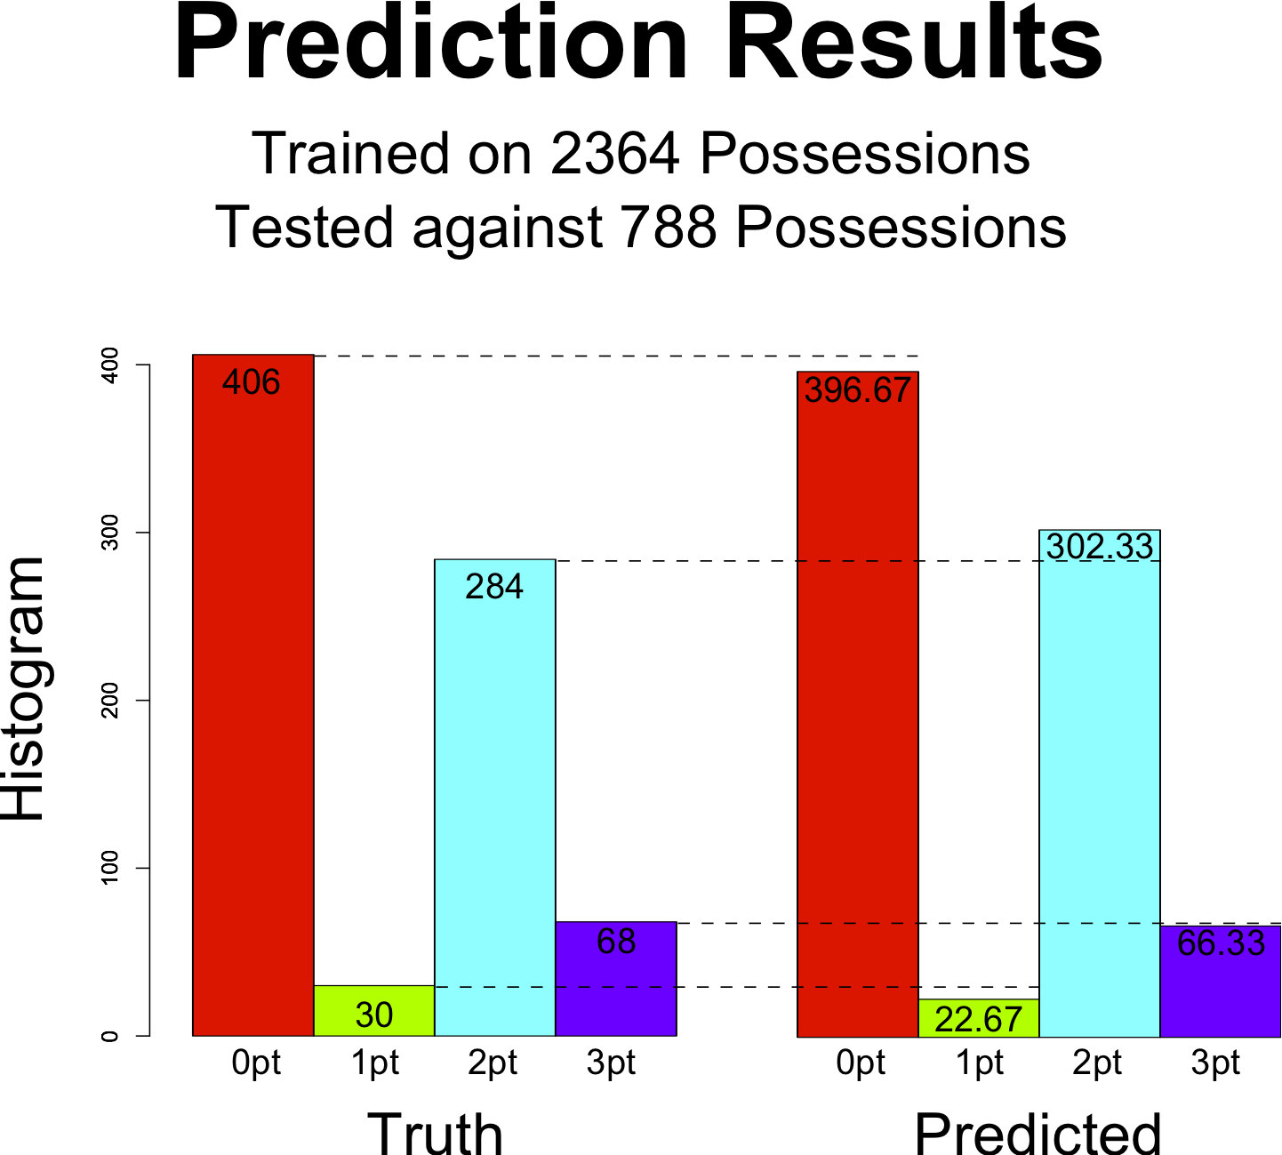
Southwest Division 2008-2009
Offensive Skills: Higher the better
Defensive Skills: Lower the better
2 pt Off./Def. Players
(600+ possessions)
35 games; 3152 1st half possessions*
Off. 2 pt | Def. 2 pt | Player
0.478 | -0.528 | Jason Terry
0.620 | -0.270 | Yao Ming
0.391 | -0.179 | Luis Scola
-0.029 | -0.029 | League Avg.
-0.480 | 0.033 | Ron Artest
-0.195 | 0.452 | Rasual Butler
-0.482 | 0.398 | Dirk Nowitzki

Slide 7
Case Study: Dallas Mavericks
Offensive/Defensive Skills
 | Off. 1 pt | Off. 2 pt | Off. 3 pt | Def. 1 pt | Def. 2 pt | Def. 3 pt
Jason Terry | -527.858 | 0.478 | -1.836 | 180.376 | -0.528 | 12.050
Jason Kidd | -55.968 | 0.205 | -2.996 | 64.236 | -0.261 | 10.115
Dirk Nowitzki | 466.984 | -0.482 | 0.353 | 105.667 | 0.398 | -6.913
League Avg. | -0.197 | -0.029 | -0.137 | -0.197 | -0.029 | -0.137
Offensive Skills: Higher the better
Defensive Skills: Lower the better
35 games; 3152 1st half possessions*

Slide 8
Future Work
Conclusion
Smoothing/Bayesian Prior
Coach Skill
Even More Data
Rank players by individual contribution that traditional box scores cannot convey
Generative model can predict the performance of lineups that have never faced each other
Built multinomial multi-player models of multidimensional skills on top of basic paired-comparison models.

